Slide 1
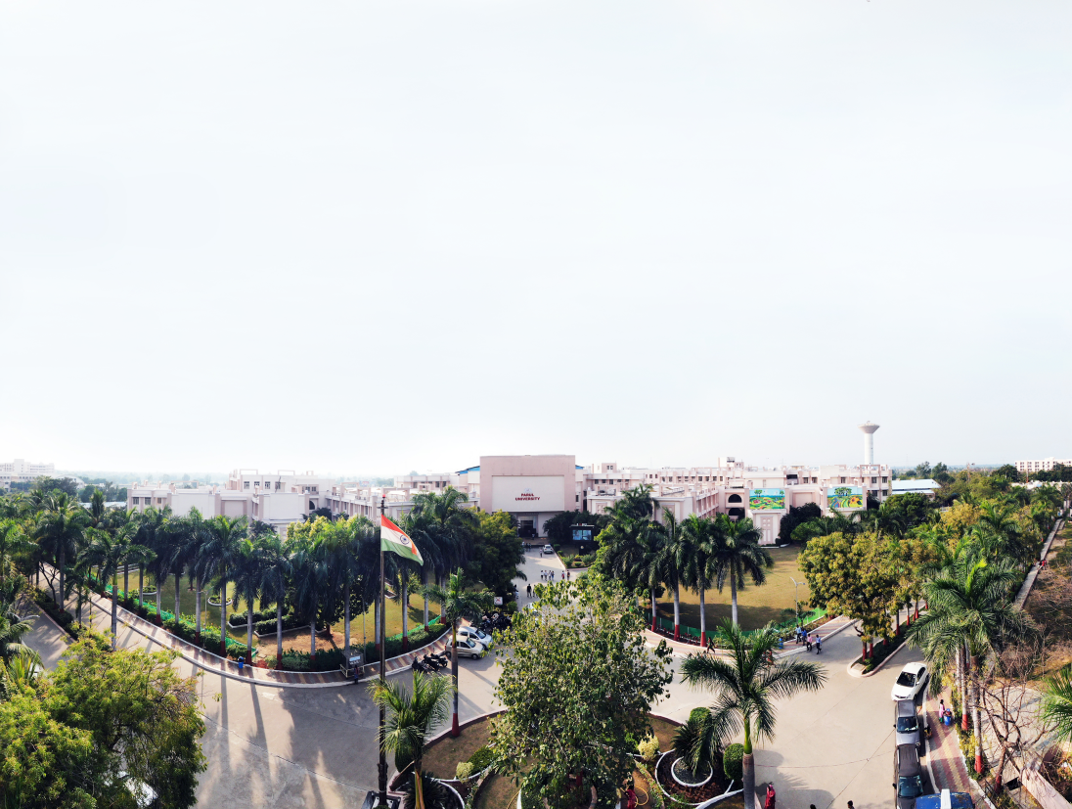

Operating System
203105203
Prof. Riddhi Mehta & Prof. Rumana Shaikh, Assistant Professor
Computer Science & Engineering Department

Slide 2
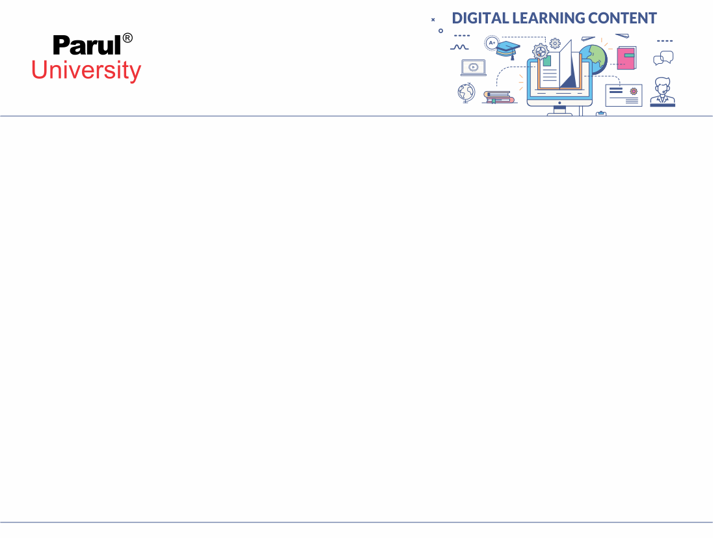

CHAPTER-5.2
Virtual Memory

Slide 3
Topics to be Covered
Basics of Virtual Memory
Hardware and control structures
Locality of reference
Page fault
Working Set
Dirty page/Dirty bit
Demand paging
Page Replacement algorithms: Optimal
First in First Out (FIFO), Second Chance (SC),
Not recently used (NRU) and Least Recently used (LRU).

Slide 4

Topicsto be Covered
Concept of Paging
2. Concept of Demand Paging
3. Reviewing Paging and Page Replacement
4. Page Replacement Algorithams
5. Conclusion
6. References

Slide 5
Virtual Memory
The goal of the virtual memory is to keep many processes in execution.
It is a technique that allows the execution of processes those are not completely in main memory.
In real time the size of programs are very large. So it is difficult to store whole program in main memory.
To solve this problem Virtual Memory is used.

Slide 6
Virtual Memory
Virtual Memory is provides space to store large programs in form of pages.
When programs are in execution then only the required pages or part of processes are loaded into the main memory.
This technique is useful when we have small physical memory and program size is very large.

Slide 7
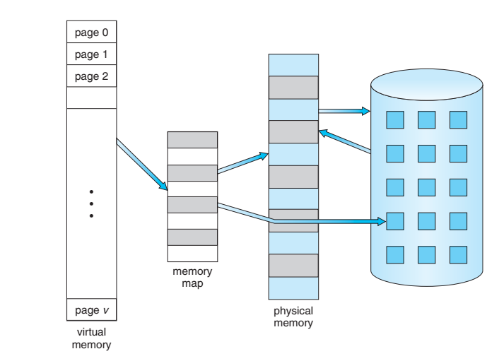
Virtual Memory
Diagram showing virtual memory that is larger than physical memory
Animation Example
Virtual memory largen than physical memory [5]

Slide 8
Advantages of Virtual Memory
  Virtual memory will help to increase the speed when only a particular segment of the program is required for the execution of the program.
  It is very helpful in implementing a multiprogramming environment.
  It allows you to run more applications at once.
  It helps to fit many large programs into smaller programs.

Slide 9
Advantages of Virtual Memory
  Similar type of data or code may be shared between memory.
  The code can be stored anywhere in physical memory without requiring relocation.
  More processes should be maintained in the M.M., which increases the effective use of CPU.
  Each page is placed on a disk until it is required after that, it will be erased.

Slide 10
Disadvantages of Virtual Memory
  If the system is using virtual memory then applications running speed is slower down.
  It will takes more time to perform switching between applications.
  Hard drive space is reduced.
  It reduces system stability.

Slide 11
Disadvantages of Virtual Memory
  It allows larger applications to run in systems that don't offer enough physical RAM alone to run them.
  It doesn’t perform same as RAM.
  It negatively affects the overall performance of a system.
  Occupy the storage space, which may be used or else for long term data storage.

Slide 12
Locality of Reference
Locality of reference refers to a computer program tends to access same set of memory locations for a specific time period.
In other words, Locality of Reference refers to the tendency of the computer program to access instructions whose addresses are near one another.
The property of LOR is mainly shown by subroutine calls and loops in a program.

Slide 13
Locality of Reference
It is based on the principle of locality of reference.
There are two different ways using which data or instruction is fetched from M.M. and get stored in cache memory.
These two ways are the following:
  Temporal Locality[6]
  Spatial Locality[6]

Slide 14
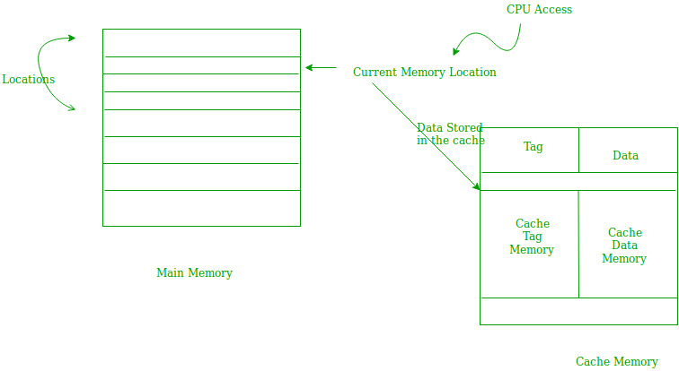
1) Temporal Locality
Temporal locality means current data or instruction that is being fetched may be required soon. So we should store that data or instruction in the cache memory so that we can avoid again searching in main memory for the same data.
Working of Temporal Locality[6]

Slide 15
2) Spatial Locality
Spatial locality means instruction or data near to the current memory location that is being fetched, may be required soon in the near future.
This is slightly different from the temporal locality. Here we are talking about nearly located memory locations while in temporal locality we were talking about the actual memory location that was being fetched.

Slide 16
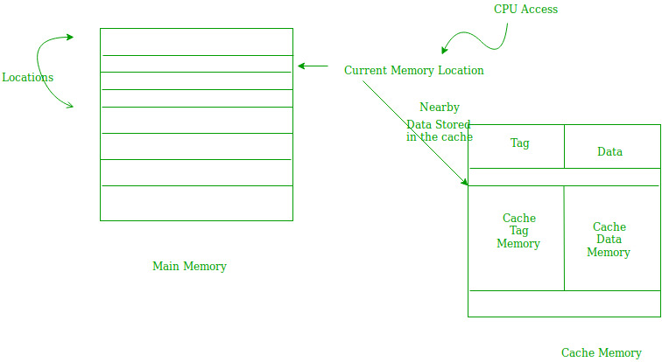
2) Spatial Locality
Working of Spatial Locality [6]

Slide 17
Page Fault
When the process tries to access a page that was not available into memory, it causes a Page Fault.
When process tries to get the page which valid/invalid bit is set to invalid, indicates the page is not loaded to memory, lazy pager generates the page fault to the operating system.
So later on that page should be brought to the main memory.

Slide 18
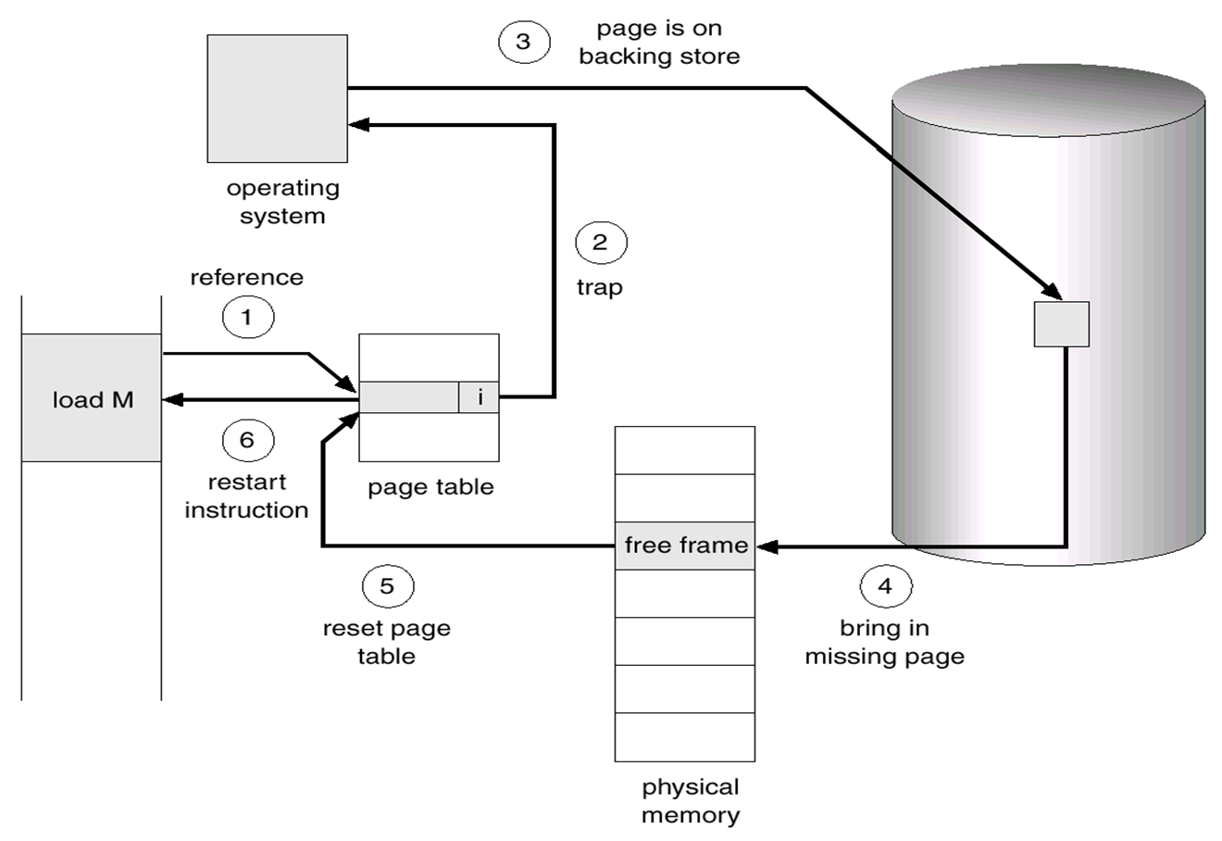
Steps in Handling a Page Fault
Animation Example
Steps to handling a page fault[5]

Slide 19
Steps in Handling a Page Fault
First we need to check an internal table for the process, to check whether the reference was a valid or invalid memory access.
If the reference was invalid, we need to terminate the process. But if in case it was valid, but we have not yet brought in that page, we now page it in.
We find a free frame.

Slide 20
Steps in Handling a Page Fault
We schedule a disk operation to read the desired page into the newly allocated frame.
When the disk reading task is complete, we modify the internal table kept with the process and the page table to indicate that page is now in memory.
We restart the instruction that was interrupted by the illegal address trap.

Slide 21
Dirty Pages
Dirty pages are the pages in memory (page cache) that have been rationalized and consequently have changed from what is currently stored on disk.
This usually happens when an existing file on the disk is altered or appended.

Slide 22
Dirty Bits / Modified Bits
To reduce the page fault service time, a special bit called the dirty bit can be associated with each page.
A dirty bit or modified bit is a bit that is related with a block of computer memory and indicates whether or not the corresponding block of memory has been modified.
Dirty bits are used by the CPU cache.
It can be also used in the page replacement algorithms of an operating system.

Slide 23
Dirty Bits / Modified Bits
Whenever the page is modified (written into) the value of dirty bit is set to ‘1’ by the hardware.
When we select a victim by using a page replacement algorithm, we needs to examine its dirty bit.
If the dirty bit is set, that means the page has been modified since it was swapped in. In this scenario we have to write that page into the backing store.
If the dirty bit is reset, that means the page has not been modified since it was swapped in, so we don’t have to write it into the backing store. The copy in the backing store is valid.

Slide 24
What is Paging?
• MemThe OS divides virtual memory and the main memory into units, called “pages”.
.
• Each used page can be either in secondary memory or in a page frame in main memory.
• A frame does not have to comprise a single physically contiguous region in secondary storage.

Slide 25
Concept of Demand Paging
According to the concept of Virtual Memory, in order to execute some process, only a part of the process needs to be present in the main memory which means that only a few pages will only be present in the main memory at any time.
However, deciding, which pages need to be kept in the main memory and which need to be kept in the secondary memory, is going to be difficult because we cannot say in advance that a process will require a particular page at particular time.

Slide 26
Concept of Demand Paging Continue…
Therefore, to overcome this problem, there is a concept called Demand Paging is introduced. It suggests keeping all pages of the frames in the secondary memory until they are required. In other words, it says that do not load any page in the main memory until it is required.
Whenever any page is referred for the first time in the main memory, then that page will be found in the secondary memory.

Slide 27
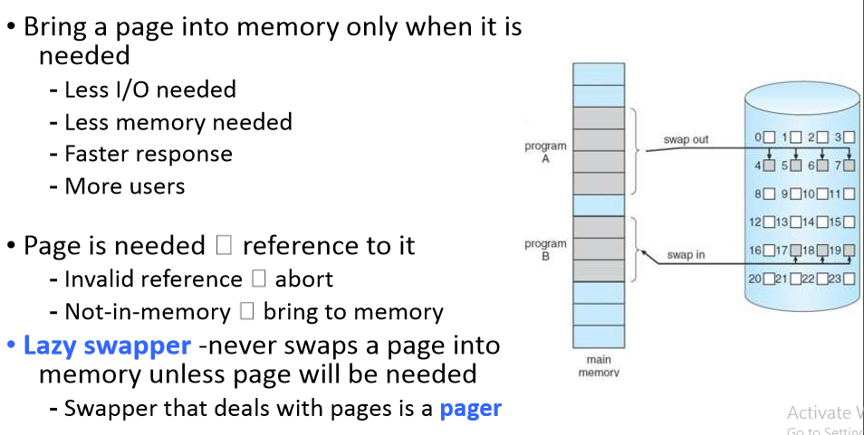
Demand Page

Slide 28
Page Fault
If there is a reference to a page, first reference to that page will trap to operating system: page fault.
If there is a reference to a page, first reference to that page will trap to operating system: page fault
Get empty frame
Swap page into frame
Reset tables
Set validation bit = v
Restart the instruction that caused the page fault

Slide 29
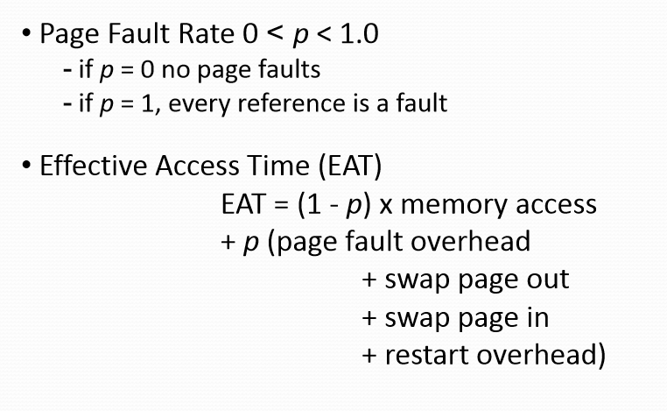
Performance of Demand Paging

Slide 30
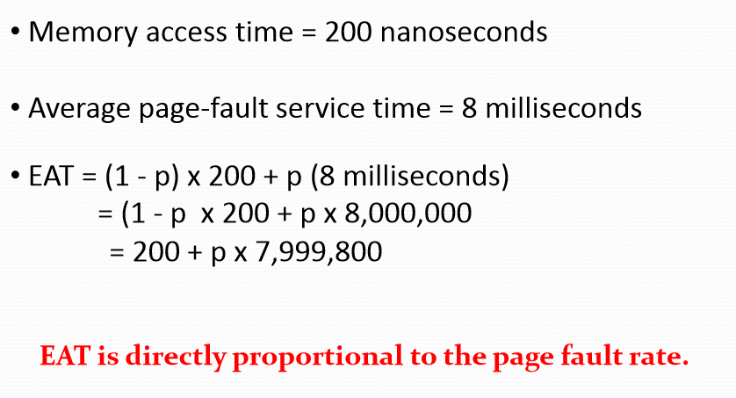
Demand Paging Example

Slide 31
HARDWARE SUPPORT
The hardware to support demand paging is the same as the hardware forpaging and swapping:
PAGE TABLE : This table has the ability to mark an entry invalid through a valid invalid bit or a special valueof protection bits.
SECONDARY MEMORY : The memory holds those pages that are not present in the main memory. The secondary memory is usuallya high speed disk. It is known as Swap Device and the section of the disk used forthis purpose is known as the Swap Space.
.

Slide 32
What happens if there is no free frame?
Page replacement - find some page in memory, but not really in use, swap it out - Algorithm - Performance - want an algorithm which will result in minimum number of page faults.
Same page may be brought into memory several times.
.

Slide 33
What is page replacement?
When memory located in secondary memory is needed, it can be retrieved back to main memory.
Process of storing data from main memory to secondary memory ->swapping out.
Retrieving data back to main memory ->swapping in

Slide 34
Page Replacement
Find the location of the desired page on the disk
Find a free frame :
If there is a free frame, use it.
If there is no free frame, use a page replacement algorithm to Selecta victim frame.
Write the victim frame to the disk, change the page and frame tables accordingly.
Read the desired page into the newly freed frame, change the page and frame tables.
Restart the user process.

Slide 35
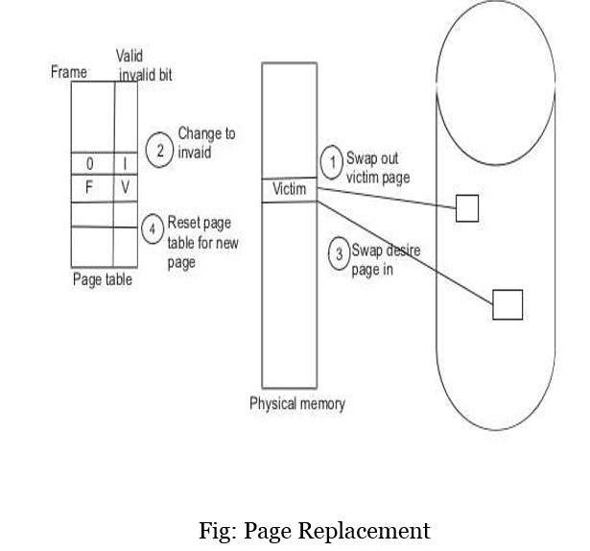
Page Replacement
)
Page Replacement

Slide 36
STEPS IN PAGE REPLACEMENT
Find the location of the desired page on the disk.
Find a free frame :
If there is a free frame, use it.
If there is no free frame, use a page replacement algorithm to Selecta victim frame.
Write the victim frame to the disk, change the page and frame tables accordingly.
Read the desired page into the newly freed frame, change the page and frame tables.
Restart theuserprocess.

Slide 37
What are Page Replacement Algorithms?
Deals with which pages need to be swapped out and which are the ones that need to be swapped in
The efficiency lies in the least time that is wasted for a page to be paged in

Slide 38
Why we need a page replacement algorithm?
The main goal of page replacement algorithms is to provide lowest page fault rate.

Slide 39
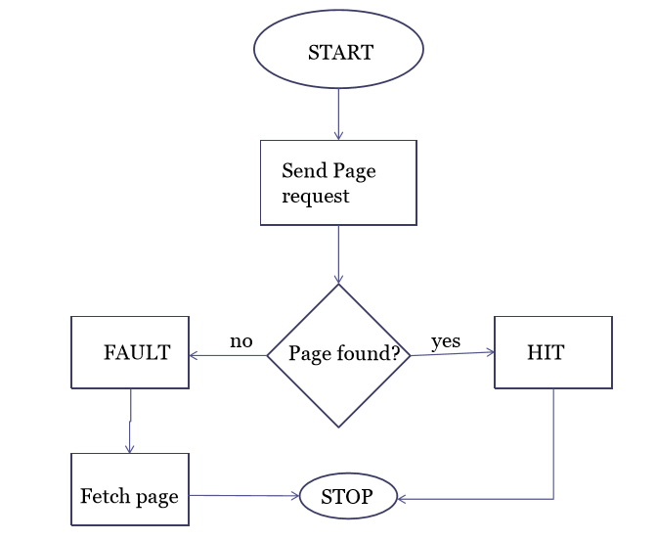
Why we need a page replacement algorithm?

Slide 40
Page Replacement Algorithms
Want lowest page-fault rate • Evaluate algorithm by running it on a particular string of memory references (reference string) and computing the number of page faults on that string
In all our examples, the reference string is
7,0,1,2,0,3,0,4,2,3,0,3,2,1,2,0,1,7,0,1

Slide 41
FIFO page replacement
Simplest page replacement algorithm
FIFO: First In First Out
Associate with each page the time when that page was brought into memory
When page must be replaced oldest page is chosen.
We can create a FIFO queue to hold all pages in memory.
We replace page at the head of the queue.
When page is brought into memory we replace insert it at the tail of the queue
For our example of reference string we consider three frames
These three frames are initially empty.
FIFO page replacement works as below

Slide 42
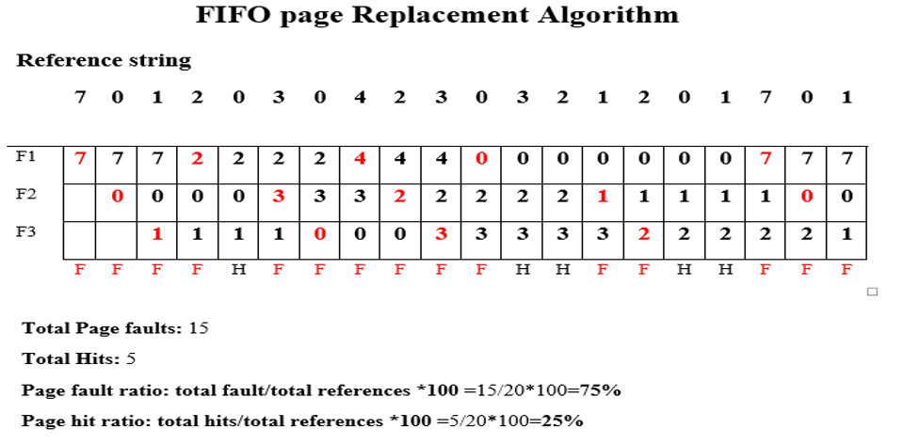
•

Slide 43
Drawbacks - FIFO
A page which is being accessed quite often may also get replaced because it arrived earlier than those present
Ignores locality of reference. A page which was referenced last may also get replaced, although there is high probability that the same page may be needed again.

Slide 44
Optimal Page replacement
Optimal page replacement has lowest page fault rate of all algorithms will never suffer from Baladys Anomaly.
“replace the page that will not be used for longest period of time”
Difficult to implement because it requires future knowledge of reference string.

Slide 45
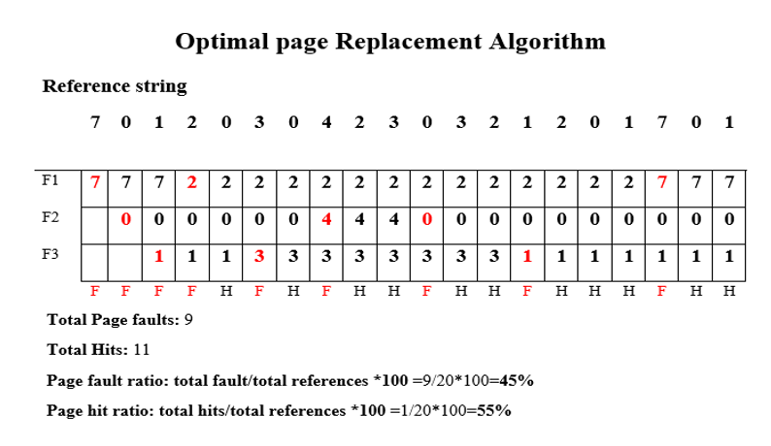
Optimal Page replacement

Slide 46
LRU Page Replacement
LRU: Least Recently Used
FIFO: uses when page is brought into memory.
Optimal: Uses time when a page to be used.
Replace a page that has not been usedfrom longest period of time.
When a page must be replaced, LRU choses a page that has not been used from longest period of time.
Looking backward in time.

Slide 47
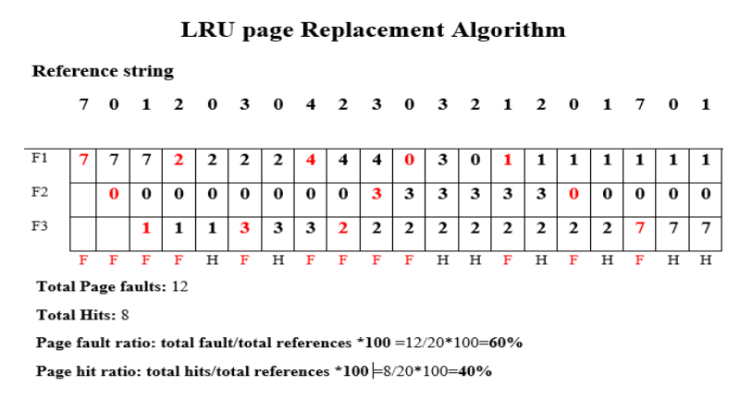

Slide 48
LRU Approximation
Few computer system provides sfficient hardware support for LRU page replacement.
Some system provide no hardware support and other page replacement algorithm must be used.
Many system provide reference bits.
Reference bit is set by hardware whenever page is referenced.
reference bit is associated with each entry in page table.
Initially bits are cleared (to0)by OS.
A user process executes the bit associated with each page referenced is set (to 1) by hardware.
After some time we determine which page have been used and have not been used by examining the reference bits.

Slide 49
Not Recently Used (NRU)
It favours keeping pages in memory that have been recently used.
The OS divides the pages into four classes based on usage during the last clock tick:
3. Referenced, modified
2. Referenced, not modified
1. Not referenced, modified
0. Not referenced, not modified
Pick a random page from the lowest category for removal
i.e. the not referenced, not modified pag

Slide 50
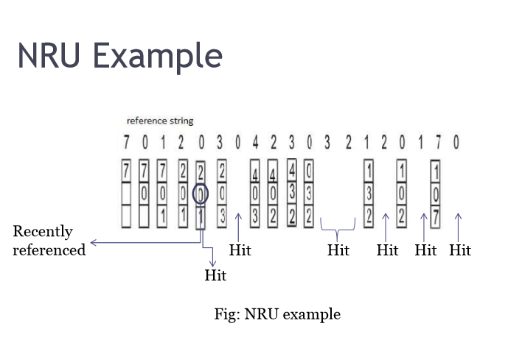
NRU EXAMPLE

Slide 51
Not frequently used (NFU)
This page replacement algorithm requires a counter
The counters keep track of how frequently a page has been used
The page with the lowest counter can be swapped out

Slide 52
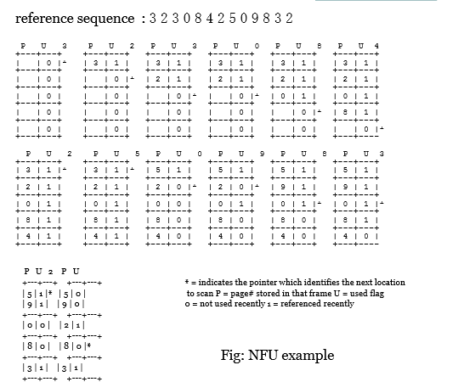
NFU EXAMPLE

Slide 53
Conclusion
Algorithm Comment
FIFO Might throw out important pages
OPTIMAL Not implementable
LRU Excellent but difficult to implement
NRU Crude approximation of LRU
NFU Crude approximation of LRU

Slide 54
References
Web Links
www.wikipedia.com
www.youtube.com
www.vbForum.com
Papers
Operating System Page Replacement Algorithms by A. Frank C. Wersberg

Slide 55
References
[1] Silberschatz, A., Galvin, P. B., & Gagne, G. (2005). Operating system concepts. Hoboken, NJ: J. Wiley & Sons.
[2] Stallings, W. (2018). Operating systems: Internals and design principles.
Prentice-Hall
[3] Tanenbaum, A. (2014). Modern operating systems. Harlow: Pearson.
[4] Operating System Generations. Tutorialspoint. https://www.tutorialspoint.com/operating-system-generations
[5] Image source www.google.com
[6] Locality of Reference. Geeksforgeeks
https://www.geeksforgeeks.org/locality-of-reference-and-cache-operation-in-cache-memory/

Slide 56


www.paruluniversity.ac.in

